Slide 1
Multimedia – An Introduction
Lecture-1

Slide 2
To discuss…
Course Issues
Multimedia – Definitions
Multimedia System
Data Stream & continuous media
Streaming Media
Multimedia - Applications
09-Jan-07
Multimedia Computing (EA C473)

Slide 3
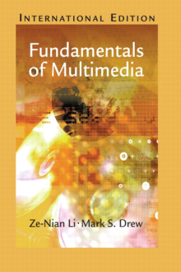
Course Issues
Course Home
  http://discovery.bits-pilani.ac.in/discipline/csis/vimal/Course.htm
Text Books
1) Ze-Nian Li & Mark S. Drew, "Fundamentals of Multimedia",
Pearson Education, 2004
2) Steinmetz R & Nahrstedt K,
“Multimedia: Computing, Communication & Applications”,
Pearson Education, 2001
In Addition to reference books, Additional readings & the class notes will be posted on the course page on a regular basis.
Multimedia Computing

Slide 4
Multimedia- Definitions
  Multi - many; much; multiple
  Medium - a substance regarded as the means of transmission of a force or effect; a channel or system of communication, information, or entertainment
        (Merriam-Webster Dictionary )
So, Multimedia???
  The terms Multi & Medium don’t seem fit well
  Term Medium needs more clarification !!!

Slide 5
Multimedia- Definitions
Perception
Medium
  Means for distribution and presentation of information
Classification based on perception (text, audio, video) is appropriate for defining multimedia
Presentation
Representation
Criteria for the classification of medium
Storage
Transmission
Information Exchange

Slide 6
Multimedia- Definitions
Time always takes separate dimension in the media representation
Based on time-dimension in the representation space, media can be
  Time-independent (Discrete)
    Text, Graphics
  Time dependent (Continuous)
    Audio, Video
    Video, sequence of frames (images) presented to the user periodically.
    Time dependent aperiodic media is not continuous!!
  Discrete & Continuous here has no connection with internal representation !! (relates to the viewers impression…)

Slide 7
Multimedia- Definitions
Multimedia is any combination of digitally manipulated text, art, sound, animation and video.
A more strict version of the definition of multimedia do not allow just any combination of media.
It requires
  Both continuous & discrete media to be utilized
  Significant level of independence between media being used
The less stricter version of the definition is used in practice.

Slide 8
Multimedia- Definitions
Multimedia elements are composed into a project using authoring tools.
Multimedia Authoring tools are those programs that provide the capability for creating a complete multimedia presentations by linking together objects such as a paragraph of text (song), an illustration, an audio, with appropriate interactive user control.

Slide 9
Multimedia- Definitions
By defining the objects' relationships to each other, and by sequencing them in an appropriate order, authors (those who use authoring tools) can produce attractive and useful graphical applications.
To name a few authoring tools
  Macromedia Flash
  Macromedia Director
  Authorware
The hardware and the software that govern the limits of what can happen are multimedia platform or environment

Slide 10
Multimedia- Definitions
Multimedia is interactive when the end-user is allowed to control what and when the elements are delivered.
Interactive Multimedia is Hypermedia, when the end-user is provided with the structure of linked elements through which he/she can navigate.

Slide 11
Multimedia- Definitions
Multimedia is linear, when it is not interactive and the users just sit and watch as if it is a movie.
Multimedia is nonlinear, when the users are given the navigational control and can browse the contents at will.

Slide 12
Multimedia System
Following the dictionary definitions, Multimedia system is any system that supports more than a single kind of media
  Implies any system processing text and image will be a multimedia system!!!
  Note, the definition is quantitative. A qualitative definition would be more appropriate.
  The kind of media supported should be considered, rather the number of media

Slide 13
Multimedia System
A multimedia system is characterized by computer-controlled, integrated production, manipulation, storage and communication of independent information, which is encoded at least through a continuous (time-dependent) and a discrete (time-independent) medium.

Slide 14
Data streams
Data Stream is any sequence of individual packets transmitted in a time-dependent fashion
  Packets can carry information of either continuous or discrete media
Transmission modes
  Asynchronous
    Packets can reach receiver as fast as possible.
    Suited for discrete media
    Additional time constraints must be imposed for continuous media

Slide 15
Data streams
  Synchronous
    Defines maximum end-to-end delay
    Packets can be received at an arbitrarily earlier time
    For retrieving uncompressed video at data rate 140Mbits/s & maximal end-to-end delay 1 second the receiver should have temporary storage 17.5 Mbytes
  Isochronous
    Defines maximum & minimum end-to-end delay
    Storage requirements at the receiver reduces

Slide 16
Characterizing continuous media streams
Periodicity
  Strongly periodic
    PCM coded speech in telephony behaves this way.
  Weakly Periodic
  Aperiodic
    Cooperative applications with shared windows
Variation of consecutive packet size
  Strongly Regular
    Uncompressed digital data transmission
  Weakly regular
    Mpeg standard frame size I:P:B is 10:1:2
  Irregular

Slide 17
Characterizing continuous media streams
Contiguous packets
  Are contiguous packets are transmitted directly one after another/ any delay?
  Can be seen as the utilization of resource
  Connected / unconnected data streams

Slide 18
Streaming Media
Popular approach to continuous media over the internet
Playback at users computer is done while the media is being transferred (no waiting till complete download!!!)
You can find streaming in
  Internet radio stations
  Distance learning
  Cricket Live!!!
  Movie Trailers

Slide 19
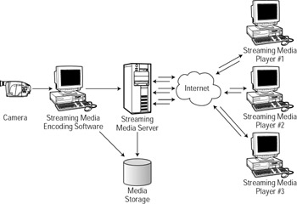
Streaming Media

Slide 20
Multimedia- Applications
Multimedia plays major role in following areas
  Instruction
  Business
      Advertisements
      Training materials
      Presentations
      Customer support services
  Entertainment
      Interactive Games

Slide 21
Multimedia- Applications
  Enabling Technology
      Accessibility to web based materials
      Teaching-learning disabled children & adults
  Fine Arts & Humanities
      Museum tours
      Art exhibitions
      Presentations of literature

Slide 22
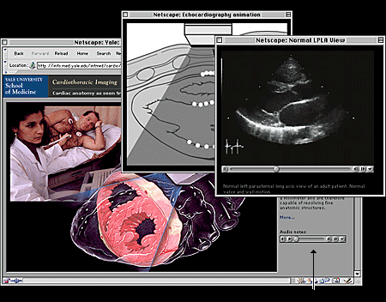
Multimedia- Applications
In Medicine
Source:
Cardiac Imaging,
YALE centre for advanced cardiac imaging

Slide 23
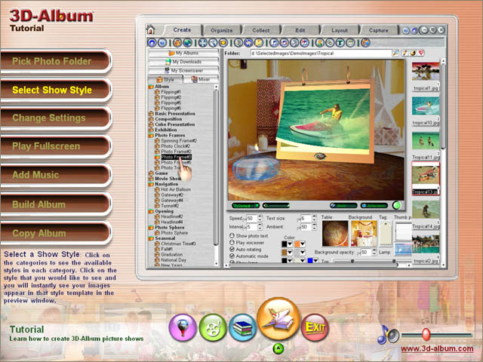
Multimedia- Applications
In training

Slide 24
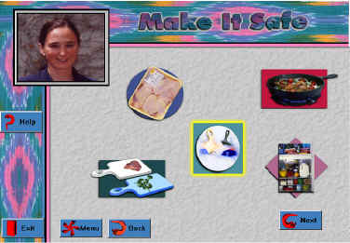
Multimedia- Applications
Public awareness campaign
Source
Interactive Multimedia Project
Department of food science& nutrition, Colorado State Univ

